Slide 1
✅ Ledger Guiding principles
Immutable, append-only ledger entries. Each state transition in a payment's lifecycle should result in new journal entries, not updates to previous ones.
The ledger is a financial event log — not a balance or status tracker.
We model each state change as a separate journal entry (or set of entries), linked to the same payment reference.
Payment Lifecycle
Requested – Customer/Operations submit a payment request
Authorized – Payment is approved by Compliance (if needed)
Initiated – Payment is created and sent to bank, funds are reserved
Posted – Payment is wired by the Banking Partner
Settled – Funds are cleared and credited/debited
Failed / Reversed – Error occurred, needs rollback
Refunded – Refund requested or initiated

Slide 2
Ledger design principles
✅ Guiding Principle
Immutable, append-only ledger entries. Each state transition in a payment's lifecycle should result in new journal entries, not updates to previous ones.
The ledger is a financial event log — not a balance or status tracker. We model each state change as a separate journal entry (or set of entries), linked to the same payment reference.
The posted amount is always positive – We never post negative amounts, not even for debits.
ΣCr = ΣDr
🧾 Journal Lifecycle
Only state changes with financial impact are captured
Initiated – Payment is created and sent to bank, funds are reserved
Posted – Payment is wired by the Banking Partner
Settled – Funds are cleared and credited/debited
Failed / Reversed – Error occurred, needs rollback
Refunded – Refund requested or initiated
Payment Lifecycle (Simplified)
Requested – Customer/Operations submit a payment request
Authorized – Payment is approved by Compliance
Initiated – Payment is created and sent to bank, funds are reserved
Posted – Payment is wired by the Banking Partner
Settled – Funds are cleared and credited/debited
Failed / Reversed – Error occurred, needs rollback
Refunded – Refund requested or initiated

Slide 3
Leger Service
Consumer
REST API
Transaction
Debit
Credit
Database updates
ASSETS
LIABILITIES
Ledger DB
EQUITY
Ledger events
Notification Service
Subscribers

Slide 4
Scenario – Incoming funds
Step 1 — Customer deposit received into operations bank account
DR Operational Bank Account (asset ↑)
CR Customer Wallet Liability (liability ↑)
Step 2 — Sweep from operational → safeguarding account
DR Safeguarded Bank Account (asset ↑)
CR Operational Bank Account (asset ↓)
Step 3 — Liability reclassification
DR Customer Wallet Liability
CR Safeguarded Client Funds Liability

Slide 5
Chart of Accounts
World
Banking Partner
Convera
Banking Circle
Bank of London
Frontier
Customer Wallet
Company Cash
Fees Revenue
FX Fees Revenues
Expenses
How much did we transfer to banking partners
How much transaction fees did we collect
How much payment did the customer make
How much fee did the customer pay

Slide 6
Key ledger events - Payments
Actor | Event
Customer | Initiates Payment
Payment Service | Confirms initial state of payment request
Compliance | Confirms On-hold state of payment request
Compliance | Confirms Released state of payment request
Banking Partner | Confirm Pending state of payment request
Banking Partner | Confirms Posted state of payment request
Banking Partner | Confirms Settled state of payment request
Archive Process | Confirms Archived state of payment request
Fees service | Confirms transaction fees

Slide 7
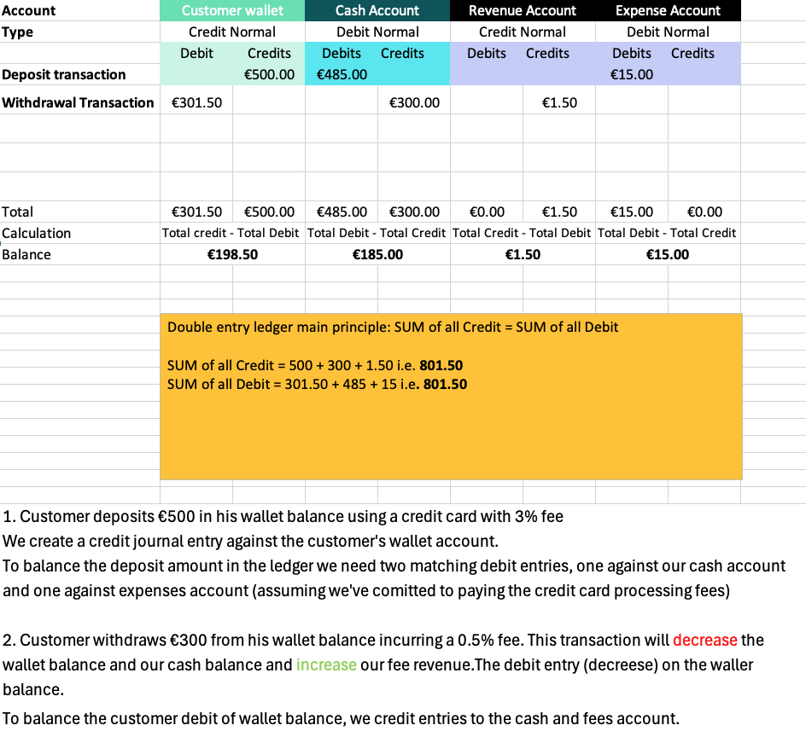
Ledger journal entry scenario

Slide 8
Ledger API - POST Customer Deposit transaction
Account Balances
Identify the Account Type: Determine whether the account is an asset, liability, equity, revenue, or expense account.
Determine the Normal Balance:
Assets, Expenses, and Dividends: Normally have debit balances (increases with debits, decreases with credits).
Liabilities, Revenue, and Equity: Normally have credit balances (increases with credits, decreases with debits).
Sum the Debits and Credits: Add up all the debit entries and credit entries for the specific account.
Calculate the Balance:
Credit normal a/c: total credits. - total debits
Debit normal a/c: Total debits - total credits
{
”ledgerId": ”Payments Ledger”,
“frontierCustomerId”: “NSPCC”,
"transactionDate": "2025-02-25,
"transactionStatus": ”Posted",
"transactionReference": ”NS20250225PAY1",
"description": ”Customer deposit transaction",
"lineItems": [
{
”accountId": ”Customer Wallet", direction: ”credit": “amount": 500
} ,
{
”accountId": ”Cash Account, direction: ”debit": “amount": 485
} ,
{
”accountId": ”Expense Account, direction: ”debit": “amount": 15
} ,
]
}

Slide 9
Ledger API - POST Customer Withdrawal transaction
Account Balances
Identify the Account Type: Determine whether the account is an asset, liability, equity, revenue, or expense account.
Determine the Normal Balance:
Assets, Expenses, and Dividends: Normally have debit balances (increases with debits, decreases with credits).
Liabilities, Revenue, and Equity: Normally have credit balances (increases with credits, decreases with debits).
Sum the Debits and Credits: Add up all the debit entries and credit entries for the specific account.
Calculate the Balance:
Credit normal a/c: total credits. - total debits
Debit normal a/c: Total debits - total credits
{
”ledgerId": ”Payments Ledger”,
“frontierCustomerId”: “NSPCC”
"transactionDate": "2025-02-25",
"transactionStatus": ”Posted",
"transactionReference": ”NS20250225PAY2",
"description": ”Customer withdrawal transaction",
"lineItems": [
{
”accountId": ”Customer Wallet", direction: ”debit": “amount": 301.50
} ,
{
”accountId": ”Cash Account, direction: ”credit": “amount": 300,
} ,
{
”accountId": ”Revenue Account, direction: ”credit": “amount": 1.50
} ,
]
}

Slide 10
ASSETS (1000–1999)
│
├── 1100 Wallet Accounts
│ ├── 1101 Wallet – Available
│ └── 1102 Wallet – Pending
│
└── 1200 Safeguarding Accounts
├── 1201 Safeguarded Customer Funds
└── 1202 Operational Float
LIABILITIES (2000–2999)
│
└── 2100 Card Clearing
└── 2101 Merchant Clearing Payable
REVENUE (5000–5999)
│
├── 5001 FX Fee Revenue
└── 5002 FX Spread Revenue
EXPENSES / P&L (6000–6999)
│
├── 6001 Realised FX Gain
└── 6002 Realised FX Loss
Account Balances
Identify the Account Type: Determine whether the account is an asset, liability, equity, revenue, or expense account.
Determine the Normal Balance:
Assets, Expenses, and Dividends: Normally have debit balances (increases with debits, decreases with credits).
Liabilities, Revenue, and Equity: Normally have credit balances (increases with credits, decreases with debits).
Sum the Debits and Credits: Add up all the debit entries and credit entries for the specific account.
Calculate the Balance:
Credit normal a/c: total credits. - total debits
Debit normal a/c: Total debits - total credits

